Slide 1
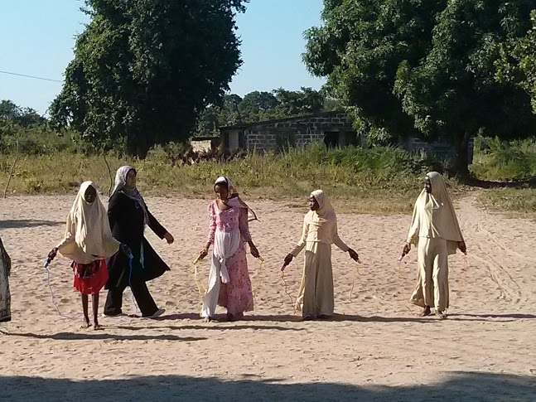
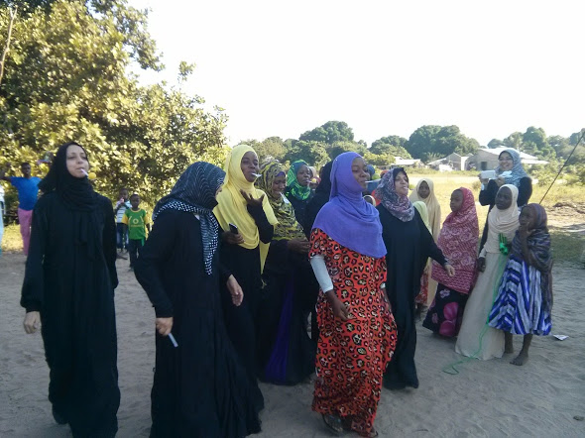
Times for game for children & tea teacher

Slide 2
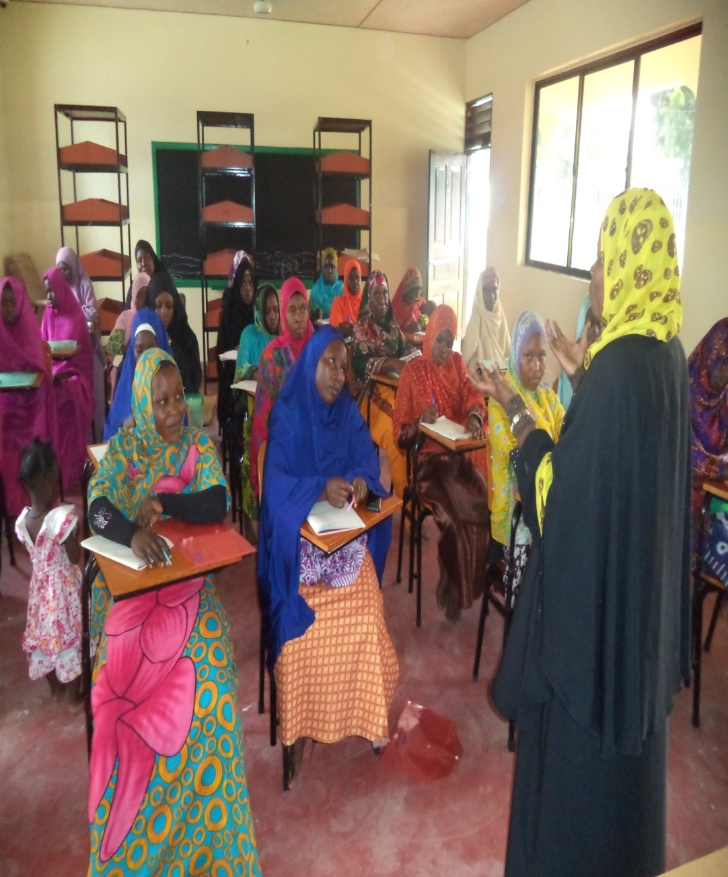
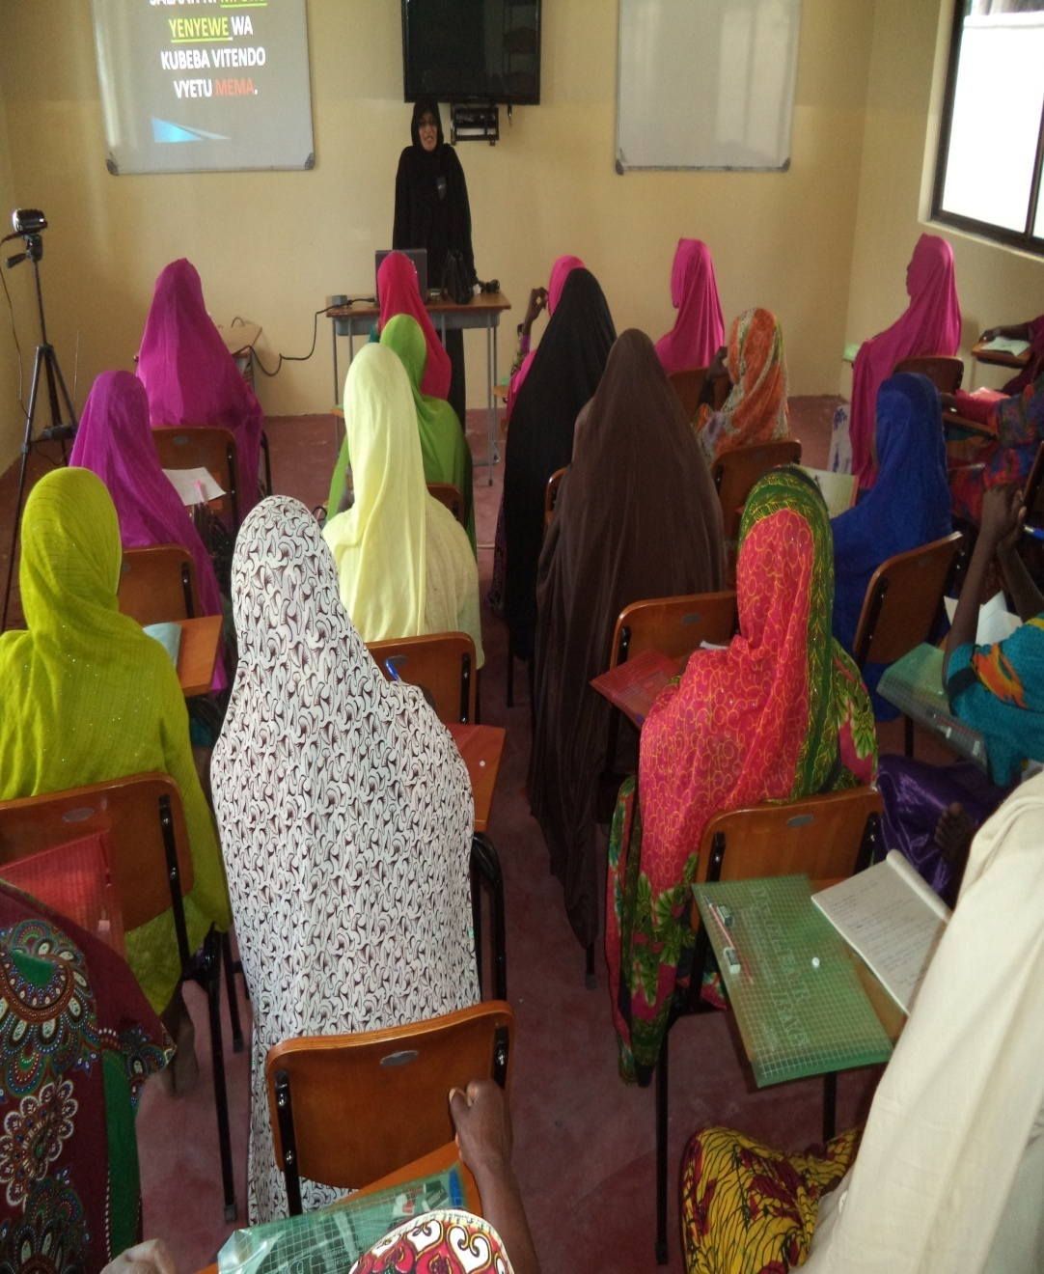
Sister Fatma Mbepeye & sister Iffet Thawer discussion on fiqh, Islamic life style, Ethics, life skills and other topics.

Slide 3
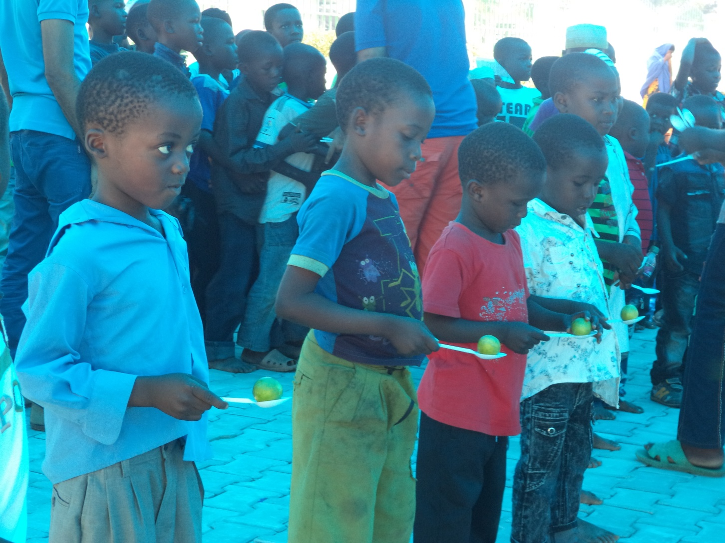
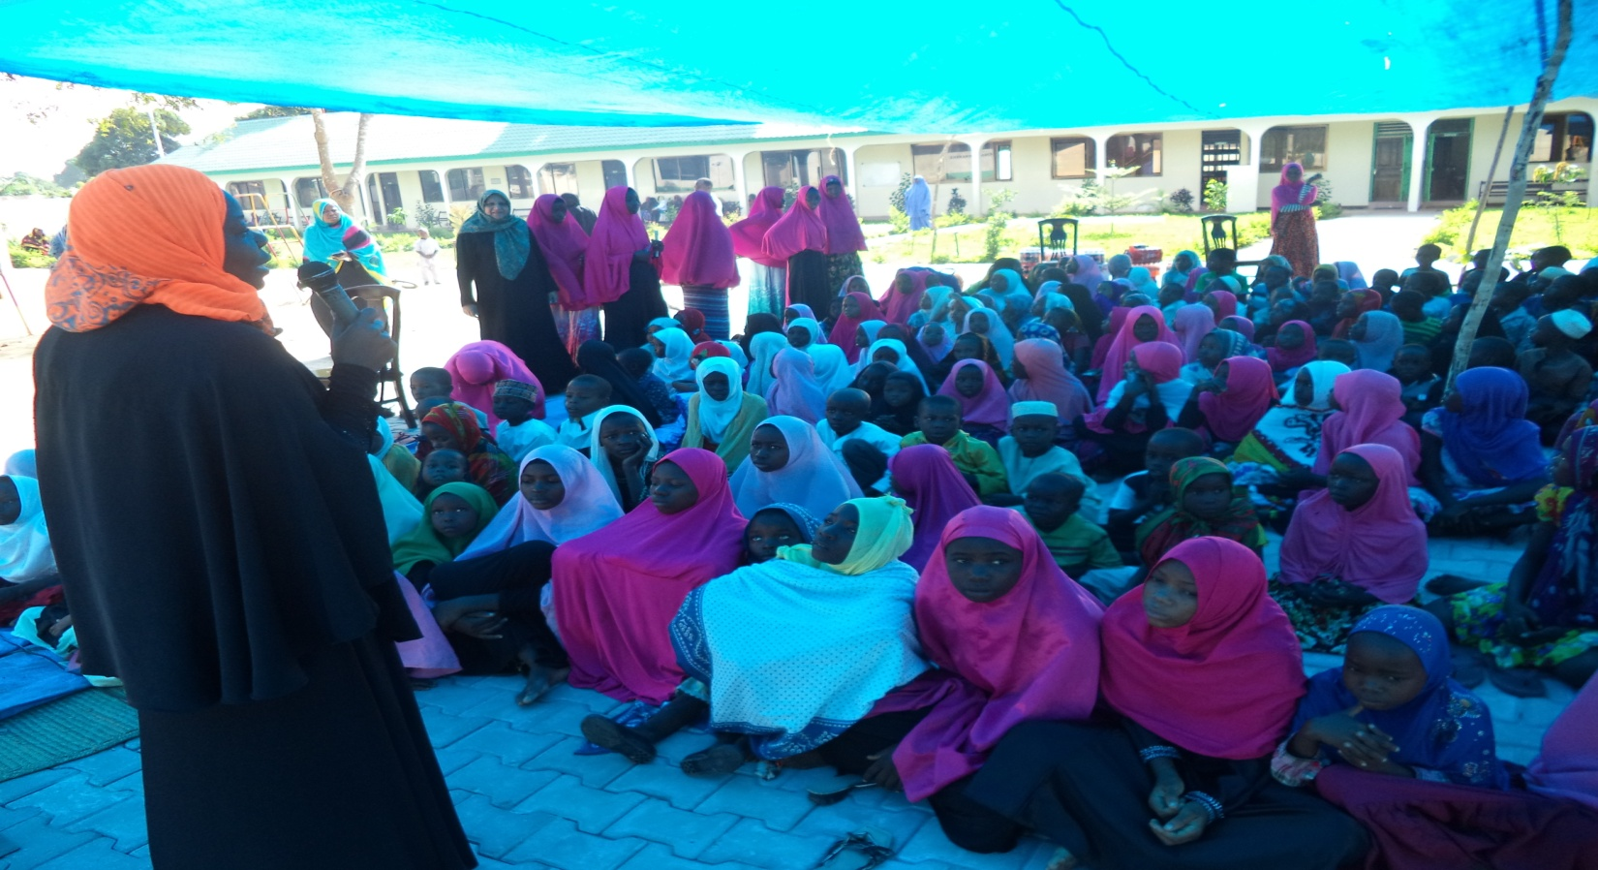
Sister Fatma Mbepeye prepairing children for games

Slide 4
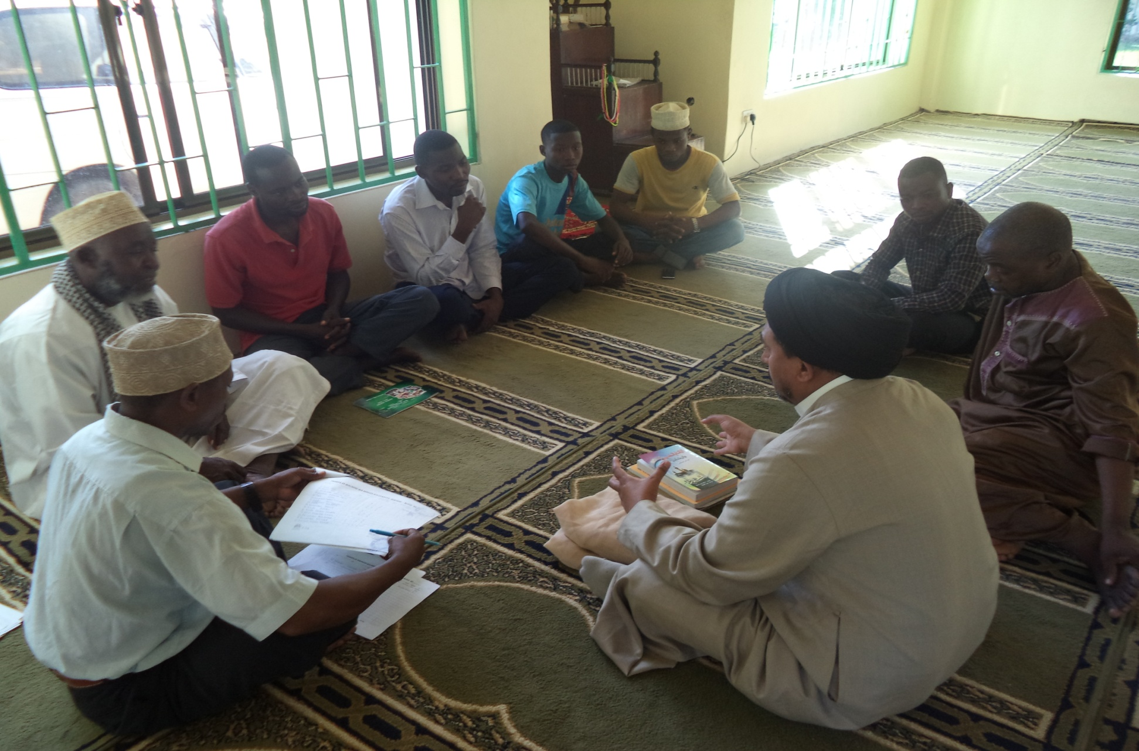
Maulana Arif in discussion with the believers at Ikwiriri

Slide 5
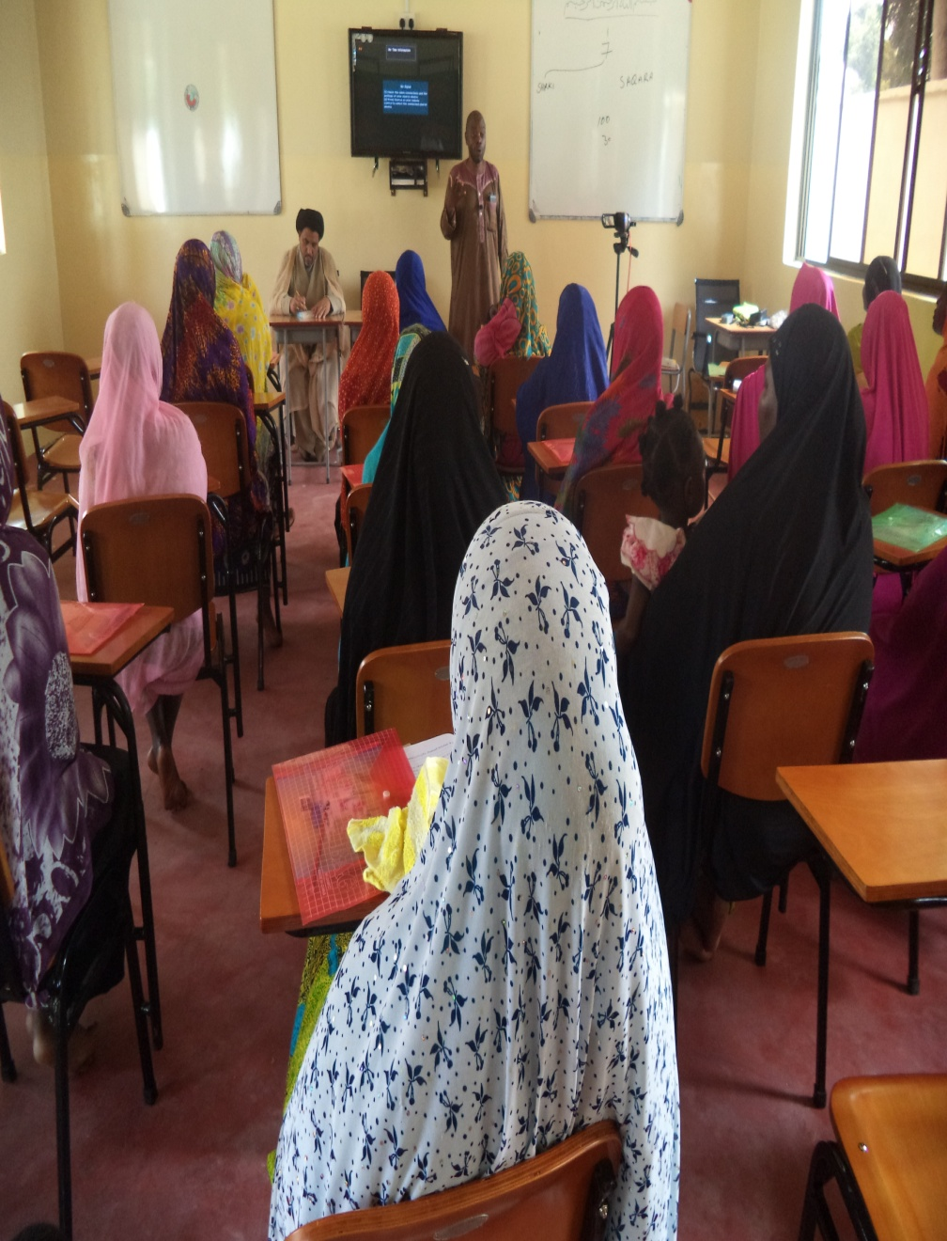
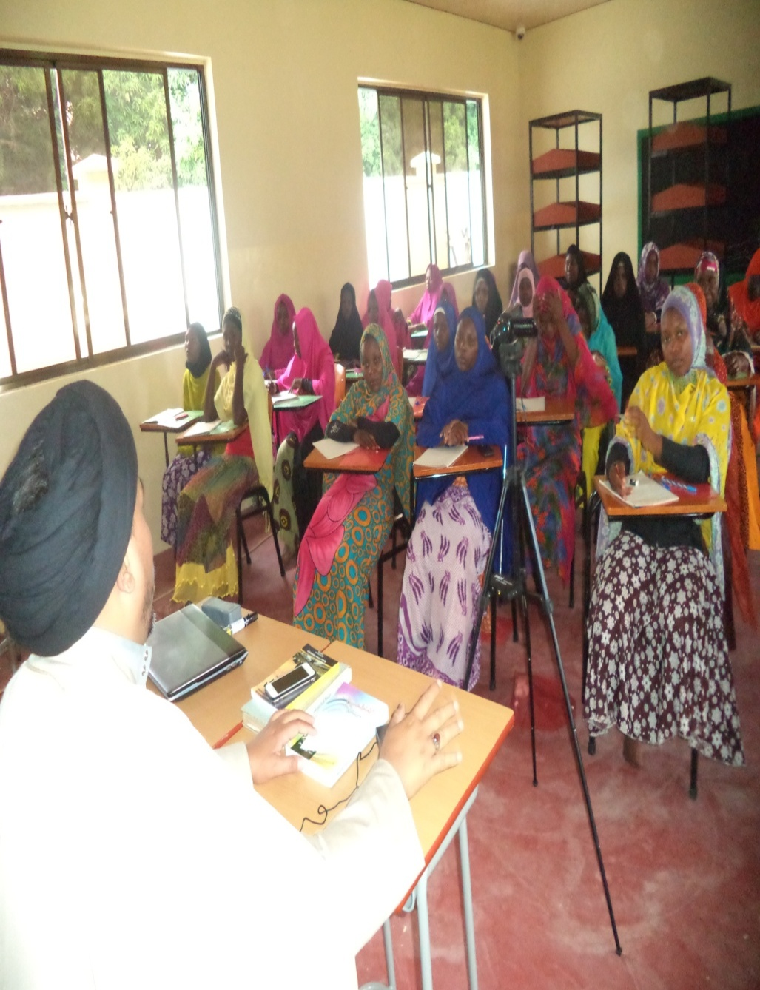
Syed Alifali & Sheikh Bakari Mbelango Facilitarting Womens Seminar at Ikwiriri.

Slide 7
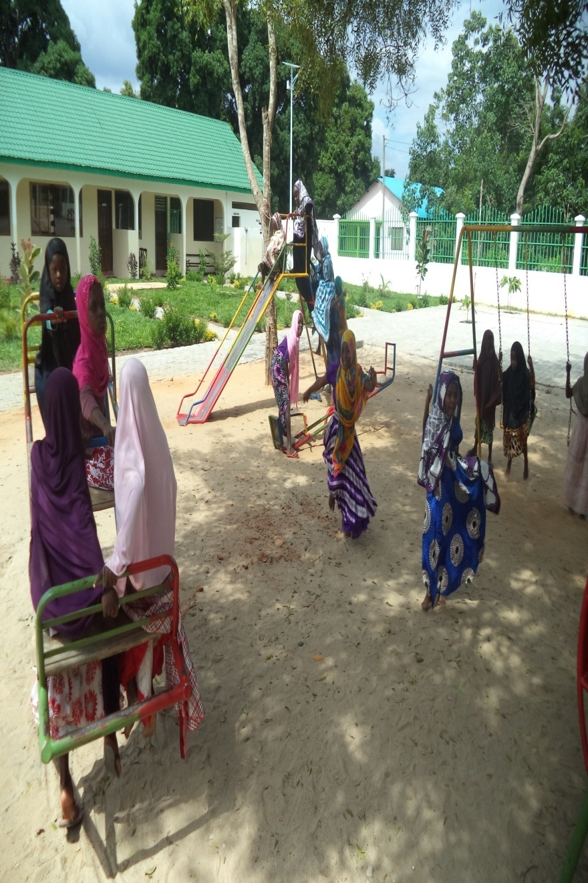
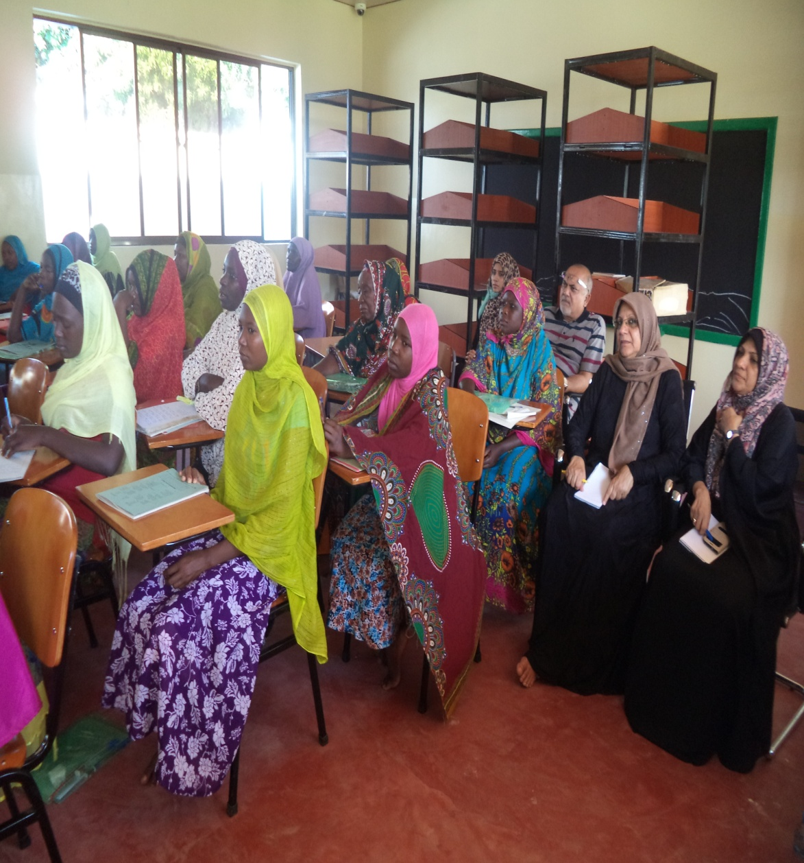
The Executive Committee at the Ikwiriri Centre

